Slide 1
Final Year Project Presentation on Emotion Detection using Speech Analysis for Different Emergency Helplines
Presented by:
Jatin Chaudhary (U17EC016)
Swastik Bhattacharya (U17EC035)
Abhishek Kumar (U17EC054)
Sachin Sharma (U17EC084)
B.Tech. – IV, ECED, SVNIT, Surat
Guided by:
Dr. Suman Deb, Assistant Professor, ECED, SVNIT, Surat
1

Slide 2
Outline
Introduction
Features generally used in emotion detection
State-of-the art algorithms in brief
Datasets and Data-preprocessing
Models Used
Discussions
Preliminary Prototyping
Challenges Faced
2

Slide 3
Introduction
The wide spectrum of lifestyle and its link to financial strata has not only diversified the population but has also given birth to different criminal hustle. The perpetual need for money and the lust for power has given rise to felonious activities. Among these, kidnapping and domestic violence are one of the most common fugitive activity being conducted in society at present.
The literature suggests that when these victims call the authority for help, they haven’t been able to utter the actual condition as if done so evidently, the hooligans might get to know, and the situation can get. In such convoluted situations, the cops have to sense the emotion with which the call has been made and hence, make a hunch on any expedient operation. This can depend on person-to-person and might lead to someone undergo a misfortune even after trying to contact the law enforcers for help.
Due to the complex nature of these problems, the authorities generally tend to make mistakes and ignore the victims in need. This modern day problem can be solved using Deep Learning.
3

Slide 4
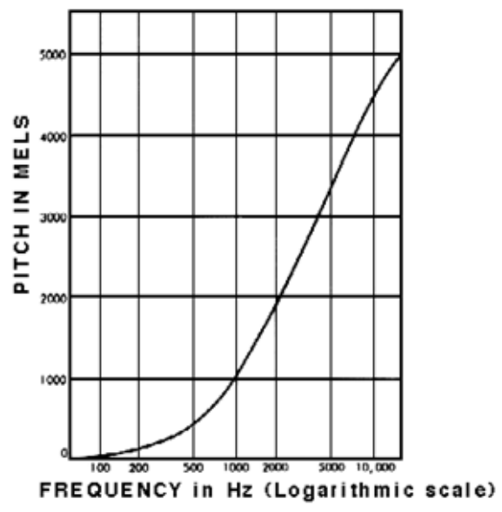
Features Used in Emotion Detection
Mel-Features
MFCCs
Delta Features
Other features such as Formant Frequencies, Chroma,
Contrast, Tonnetz etc., though available on Librosa,
are not required for SER problem.
4

Slide 5
State of the art Algorithms
Several demonstrated architectures based on DNN, CNN, GMM, HMM, etc. have provided with some satisfactory results pertaining to emotion classification in English language.
LSTM is expected and demonstrated to have superior performance, since emotions are not only related to the present input state, but also on the past input states.
Apart from LSTM, we have also explored algorithms involving Random Forests, SVMs, RBMs and CNNs.
5

Slide 6
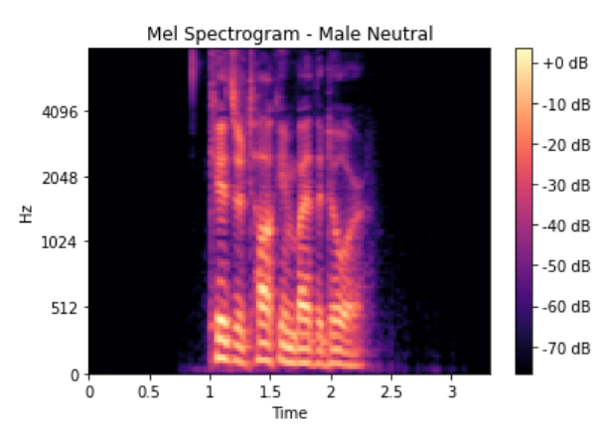
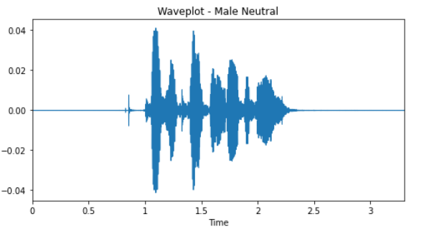
Datasets and Data-Preprocessing
Dataset used: RAVDESS
Dataset in English language which have already been used in demonstrated studies.
MFCC features extracted using Librosa in Python
Delta and Delta-Delta Coefficients also extracted, but did not demonstrate much improvement in the efficiency of machine learning models.
6
.

Slide 7
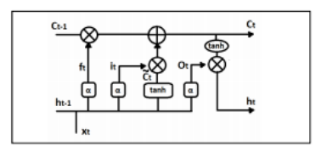
LSTM Approach
A kind of Recurrent Neural Network
The LSTM network enables the deep learning network to estimate the dependency of a particular time frame onto earlier frames.
The structure consists of gate, cells and memory. The network takes both the new information and the earlier predictions as the input, which is then gated with the information available in the memory. A selective gate then allows only those predictions as output that meet some particular condition pertaining to the earlier frames.
In this manner, the network can not only very efficiently model the temporal variations, but also look back at the memory to fine-tune the predictions.
Despite literature supporting the decent accuracy of LSTM in emotion prediction on RAVDESS, the accuracy recorded is of 7%.
7

Slide 8
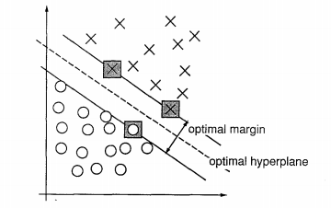
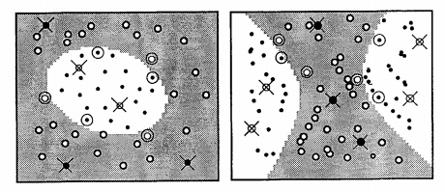
SVM Approach
SVMs used to project the data points in a training dataset to different hyperplanes.
The number of hyperplanes equals the number of classes of emotions in the training datasets.
SVM classifiers group the points in different hyperplanes into maximally separable classes on the basis of different kernels.
Most frequently used kernels are linear, polynomial and radial basis functions.
Accuracy for linear kernel: 49%
Accuracy for polynomial kernel: 28%
Accuracy for radial basis function kernel: 44%
8

Slide 9
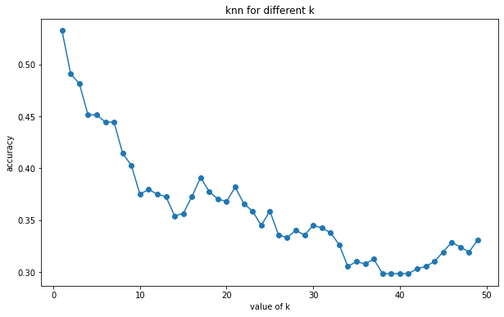
KNN-based Approach
Highest accuracy recorded: 53% for k=1
k here is the Euclidean distance between data points.
KNN is a type of classification where the function is only approximated locally and all computation is deferred until function evaluation.
Algorithm relies on distance and local structure for classification.
The training examples are vectors in a multidimensional feature space, each with a class label. The training phase of the algorithm consists only of storing the feature vectors and class labels of the training samples.
In the classification phase, k is a user-defined constant, and an unlabeled vector (a query or test point) is classified by assigning the label which is most frequent among the k training samples nearest to that query point.
9

Slide 10
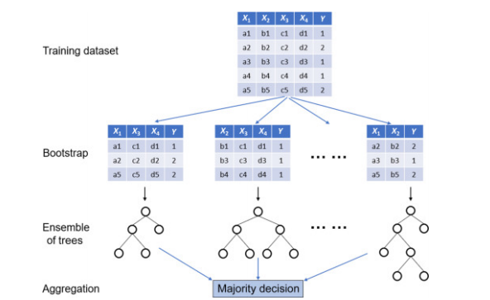
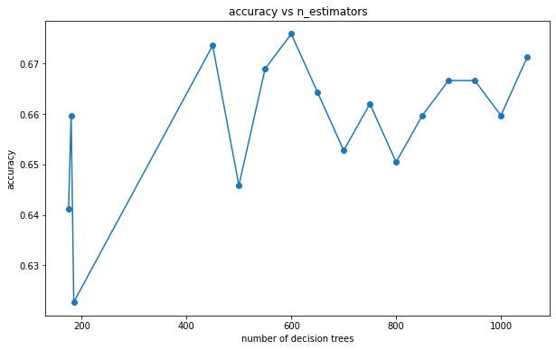
Random Forest Approach
The approach uses an ensemble of decision tree estimators, of which the aggregate of the decision of each tree is taken. A different dataset is created for each decision tree using bootstrapping. This is called bootstrap aggregation.
Random Forest classifiers were executed with different number of estimators, ranging from 100 to 1100 estimators.
From these instances, it has been observed that Random Forest Classifier with 600 decision tree estimators have shown the highest accuracy of about 67% for 8 classes of RAVDESS
10

Slide 11
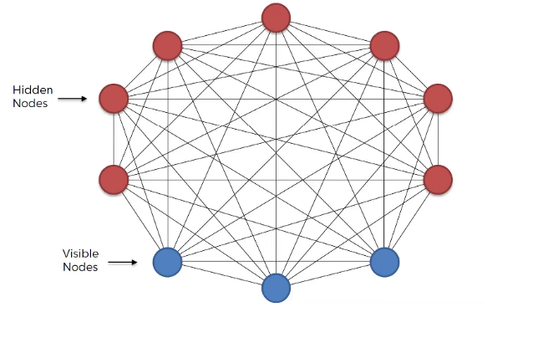
Boltzmann Machine Based - Approach
Boltzmann Machines (BMs) are bidirectionally connected networks of stochastic processing units.
These processing units can be represented with the help of neural network.
Features extracted by analyzing the probability distribution function of the training data.
Learning simplified by imposing certain restrictions on the network, giving the name Restricted Boltzmann Machine (RBM).
RBMs have 2 types of units, namely visible and hidden units. Arranged in 2 layers.
Visible units form the first layer, that correspond to the observational inputs, whereas the hidden layers model the dependencies between the constituents of the observations.
RBMs primarily function as a non-linear feature detector.
2 major steps in minimizing the reconstruction error is contrastive divergence and gibbs sampling.
11

Slide 12
RBM-based Approach (contd…)
Since RBMs function as non-linear feature extractors, it cannot be solely used for a classification problem.
A classifier has to be in the pipeline that will perform classification on the features extracted by the RBMs.
RBMs can be stacked upon one another, in hopes of better feature extraction.
In our case, the models assessed were RBM+Logistic Regression, RBM+Random Forest and RBM+RBM+RBM+Random Forest.
Accuracies Recorded:
RBM + LR: 31%
RBM + RF: 40%
RBM + RBM + RBM + RF: 27%
12

Slide 13
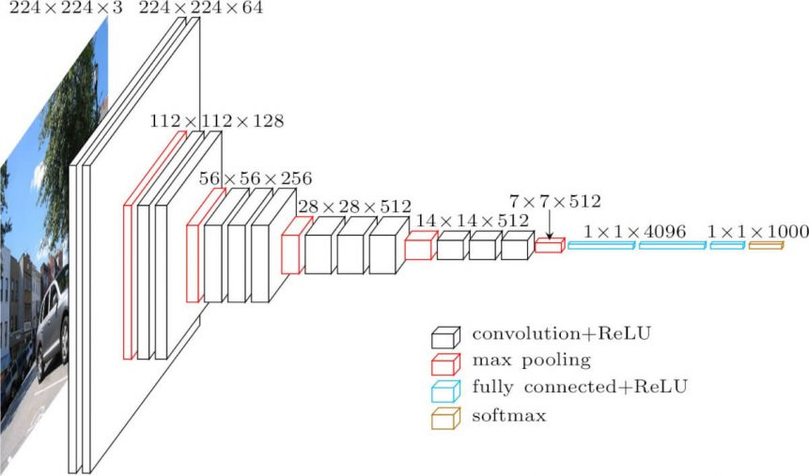
CNN-based Approach
This is a radical approach that takes the mel-spectrogram generated for an audio directly into the model as an image.
Two architectures have shown promising accuracies.
These architectures are based on the VGG-16 network architecture. They have been dubbed as the ‘Inception Model’.
The highest accuracy recorded for the model is about 93%
13

Slide 14
VGG Model
VGG16 is a convolutional neural network model proposed by K. Simonyan and A. Zisserman
The model achieves 92.7% top-5 test accuracy in ImageNet, which is a dataset of over 14 million images belonging to 1000 classes.
The input to convolutional layer 1 is of fixed size 224 x 224 RGB image. The image is then passed through a stack of similar convolutional layers.
14

Slide 15
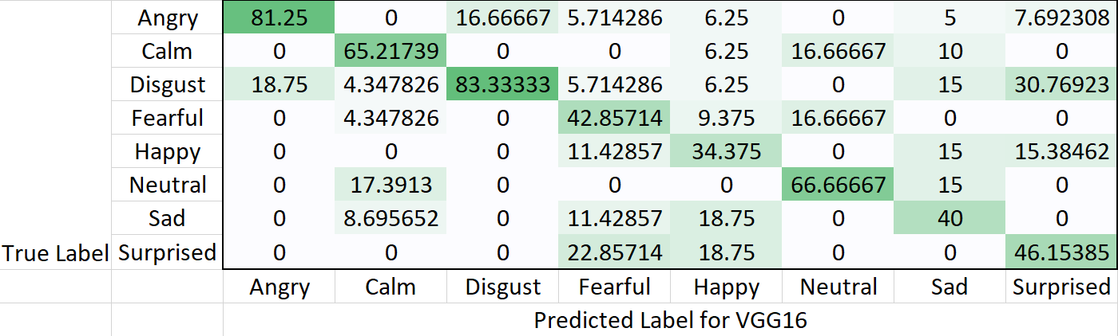
VGG 16 Results:
15

Slide 16
Cons of VGG16
Despite its incredible accuracy, there are two major drawbacks with VGG16:
1. It is very slow to train.
2. The network architecture weights themselves are huge (concerning disk/bandwidth).
16

Slide 17
Inception Model
Inception v3 is a widely-used image recognition model that has been shown to attain greater than 78.1% accuracy on the ImageNet dataset.
The model is the culmination of many ideas developed by multiple researchers over the years.
The model itself is made up of symmetric and asymmetric building blocks, including convolutions, average pooling, max pooling, concats, dropouts, and fully connected layers. Batch normalization (Batchnorm) is used extensively throughout the model and applied to activation inputs. Loss is computed via Softmax.
Each inception module consists of four operations in parallel
1. 1x1 conv layer
2. 3x3 conv layer
3. 5x5 conv layer
4. Max pooling
17

Slide 18
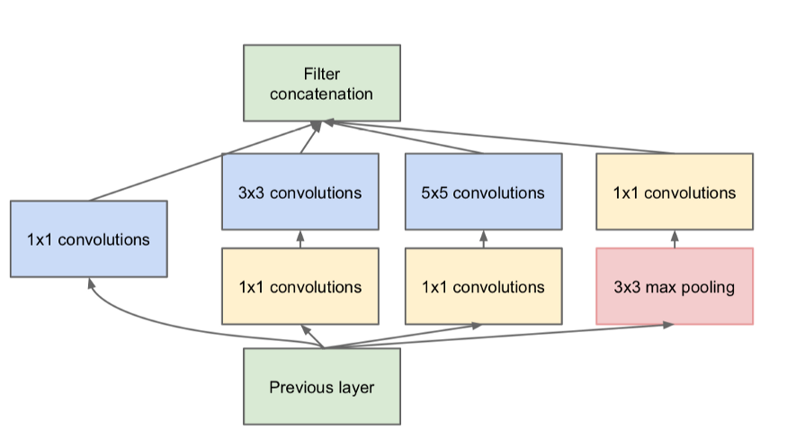
18

Slide 19
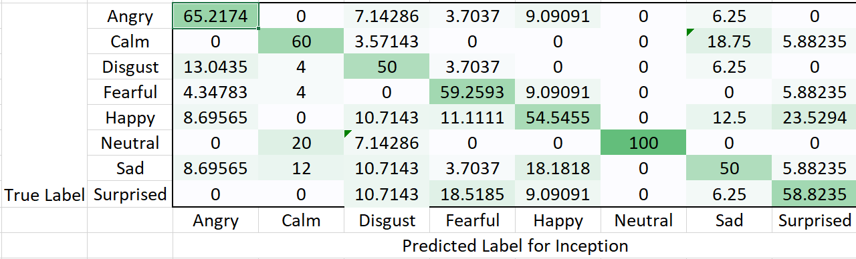
Inception Results
19

Slide 20
It fixes one of the major problems with VGG16, that is, it is computationally efficient and much faster to train than VGG16.
20

Slide 21
Preliminary Prototyping
The preliminary prototyping involves an audio recorder that can capture the sound of the speaker and simultaneously, about every 5 seconds, can display the emotion.
This involves multithreading, wherein one thread records the audio, and the other thread extracts features and performs classification using the .h5 file of the model.
For capturing audio, the library pyaudio and sounddevice is used. The prototype can be further amended to work on telephone devices.
21

Slide 22
Comparison between VGG16 and Inception model -
As one can observe, on this particular dataset, the overall accuracy is achieved to a higher value through the inception model, however, it must be noted that VGG16 is able to discern between certain emotions to a higher accuracy than Inception, as evidenced by the confusion matrix. These emotions are also the ones which actually matter more - anger, calm and disgust. However, Inception would gain the upper hand here as it is computationally more efficient and thus much more practical
22

Slide 23
Deductions
Random Forest and KNN, though computationally efficient, give classification results that have a high margin of errors as compared to other algorithms.
LSTM, SVM based methods have not been able to reproduce some of the published results, giving undesirable accuracies.
RBM based models, though having lesser efficiencies, can show promising results if the neurons can be activated in a manner that it follows the multimodal distribution of the audio features.
Inception model shows promising results for our application, since it is not only giving high accuracy, but is also showing promising outcome for audio instances that are not in English.
23

Slide 24
Challenges
Lack of enough computational capabilities.
Unavailability of reliable datasets for Indic languages.
Logistical issues due to the ongoing pandemic.
24

Slide 25
Thank You!!!
25

